Slide 1



TAXI DRIver
T-AIA-902
MSc 2022
Group 1

Slide 2
SUMMARY
Introduction
Team
Organization
Project
Feedback
Enhancements
Demonstration
Questions

Slide 3

Introduction

Slide 4





TEAM
Johan-David Dehi
Hédhie Krouk
Richard La
Pierre Bobard
Grégory Koenig

Slide 5







Organization
- COMMUNICATION -

Slide 6








Organization
- TECHNOLOGIES -

Slide 7
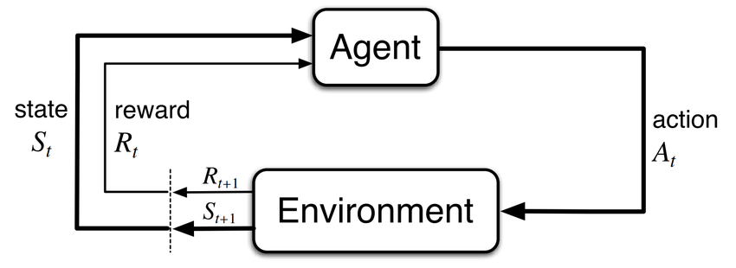
PROJECT
Basic loop approach
State / Reward / Done / Info
No learning from past experiences
- BRUTE FORCE -

Slide 8
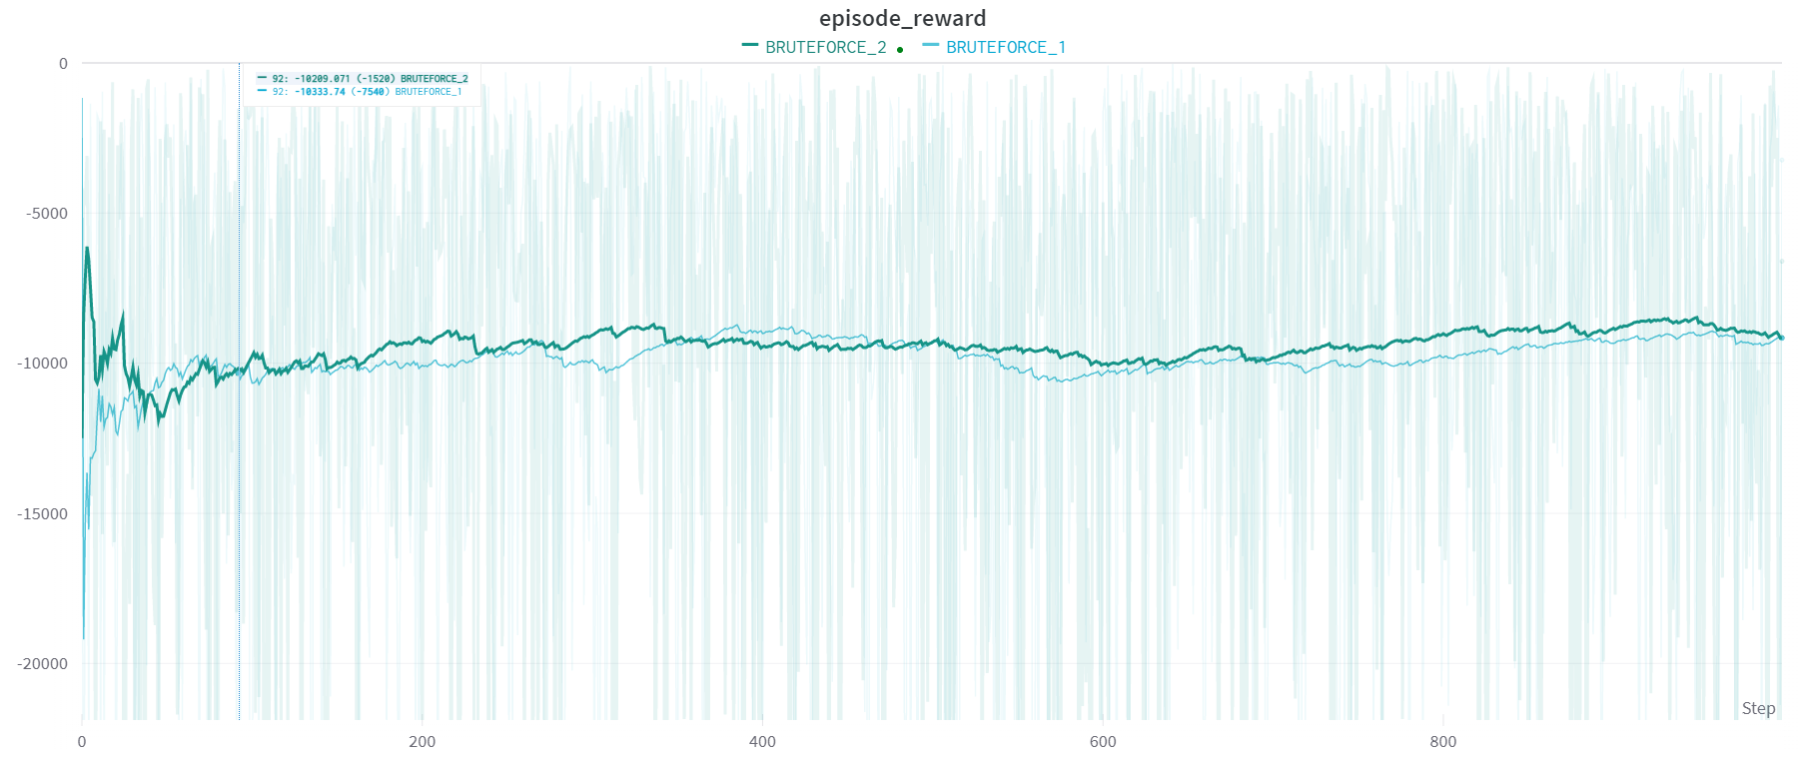
PROJECT
1000 steps run with the brute force approach
- BRUTE FORCE -

Slide 9
project
- COMPARISON CRITERIA -
General parameters
Default paramaters
Reward average
Training time average
stability

Slide 10
project
- q-learning -
Q-learning

Slide 11
project
- q-learning: Steps -
State space
Actions space
Transition Probability
Reward

Slide 12
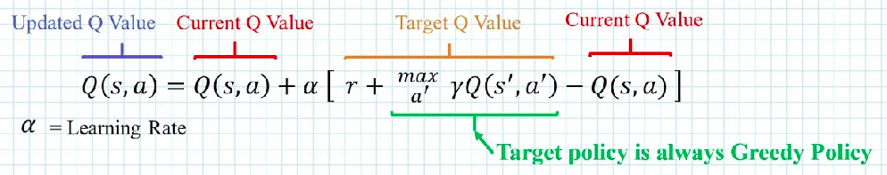
project
- q-learning: formula -

Slide 13
project
- q-learning: general parameters -
epsilon = 1
max_epsilon = 1
episodes = 25000
gamma = 0.97
min_epsilon = 0.001
epsilon_decay = 0.01
alpha = 0.44
max_steps = 99

Slide 14
project
- q-learning: default parameters -
epsilon = 1
max_epsilon = 1
episodes = 25000
gamma = 0.97
min_epsilon = 0.001
epsilon_decay = 0.01
alpha = 0.01
max_steps = 99

Slide 15
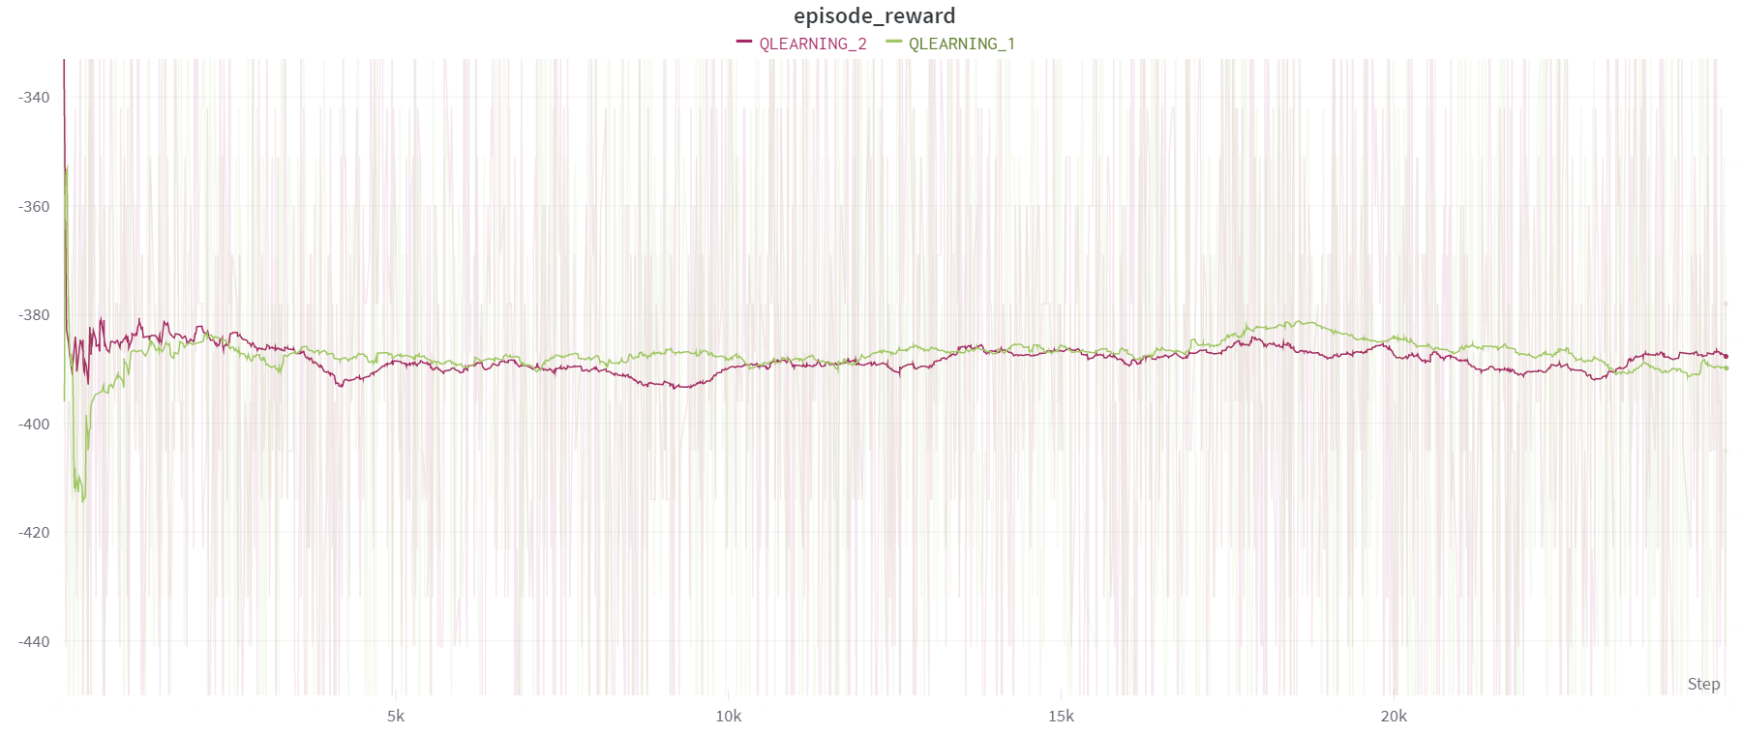
project
- q-learning: comparison -

Slide 16
Project
- sarsa -
Sarsa

Slide 17
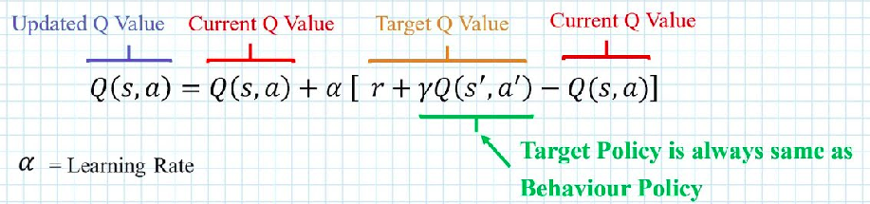
Project
- sarsa: formula -

Slide 18
Project
- sarsa: general parameters -
epsilon = 1
max_epsilon = 1
episodes = 25000
gamma = 0.97
min_epsilon = 0.001
epsilon_decay = 0.01
alpha = 0.44
max_steps = 99

Slide 19
Project
- sarsa: default parameters -
epsilon = 1
max_epsilon = 1
episodes = 25000
gamma = 0.95
min_epsilon = 0.001
epsilon_decay = 0.01
alpha = 0.85
max_steps = 99

Slide 20
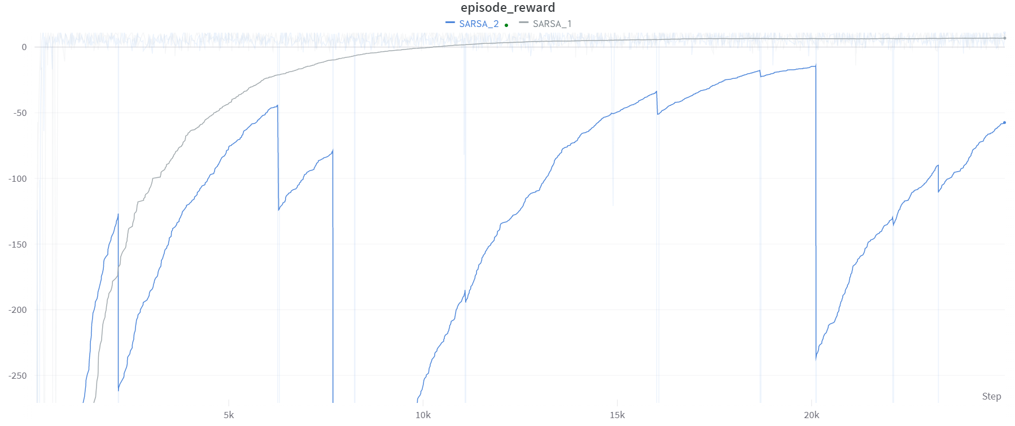
Project
- sarsa:comparison -

Slide 21
project
- dqn -
Deep Q-learning

Slide 22
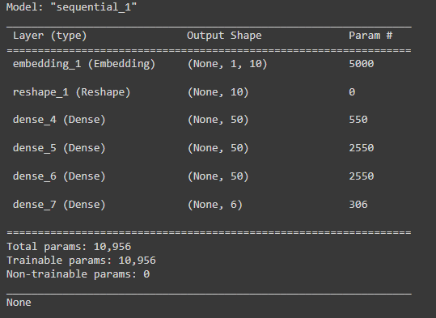
project
- DQN: model -
Sequential model
Multiple Dense layer
Last Dense layer with size of available actions

Slide 23
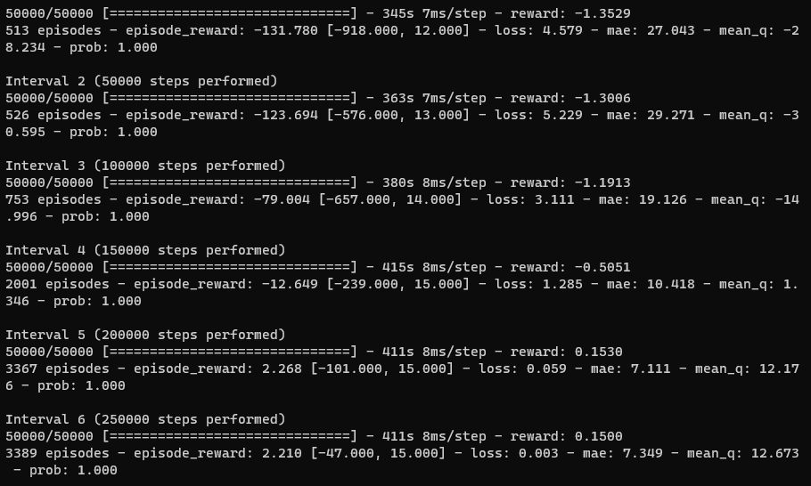
project
- DQN: training -
Preparation of the DQN Agent
Compilation with Adam optimizer
Training of the model

Slide 24
project
- DQN: testing -

Slide 25
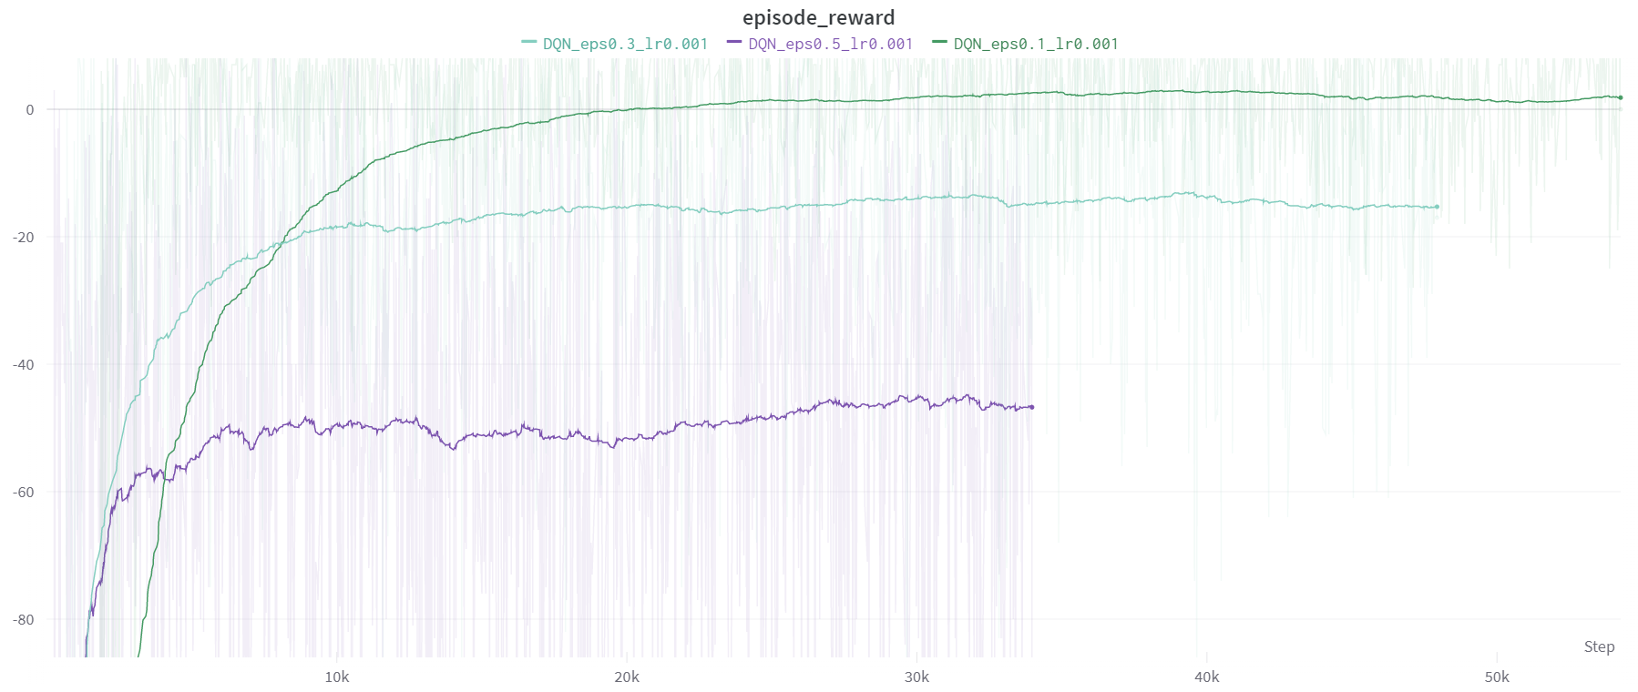
project
- DQN -
benchmark: epsilon

Slide 26
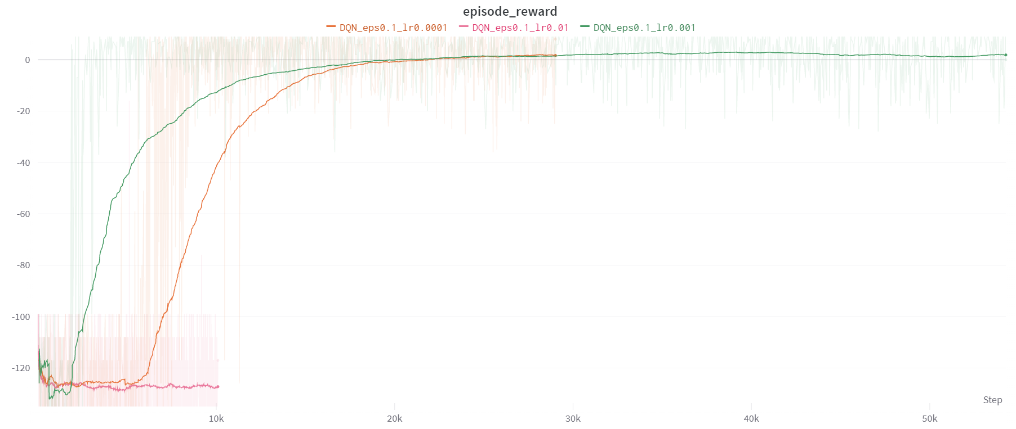
project
- DQN -
benchmark: learning rate

Slide 27
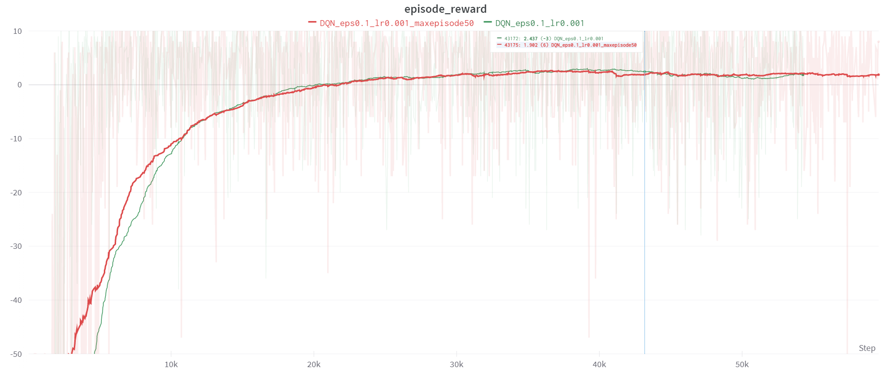
project
- DQN -
benchmark: max steps

Slide 28
project
- DQN -
benchmark: CONCLUSION
EPSILON = 0.1
Learning Rate = 0.001
STEP= 1 000 000
MAX_STEPS = 99

Slide 29
project
- conclusion: sarsa -
Parameters are important
Maximum performance quickly
account possible penalties due to exploratory movements
AVOID mistakes in the future
It depends on the context of using

Slide 30





Feedback
Learning about new algorithms
Time management with multiple project
Mob-programming
Lack of theoretical knowledge

Slide 31
ENHANCEMENTS
More time to develop each algorithm
Mathematical theory
Better UI render

Slide 32

demonstration

Slide 33

questions

Slide 34
Thanks for your attention

